Slide 1

School of Computer Engineering and Technology
CAPSTONE PROJECT
Swarm Rescue System
Project Title : Application of swarm robotics on 2d environment for disaster management using cohort intelligence
Under the Internal Guidance of : Dr. Bhavana Tiple
Under the External Guidance of : Dr. Anand Kulkarni
Group B20:
Ritika Bhosale - 1032180325
Simran Vaishya - 1032180450
Chintan Patel - 1032180608
Rohit Katyal - 1032181463

Slide 2

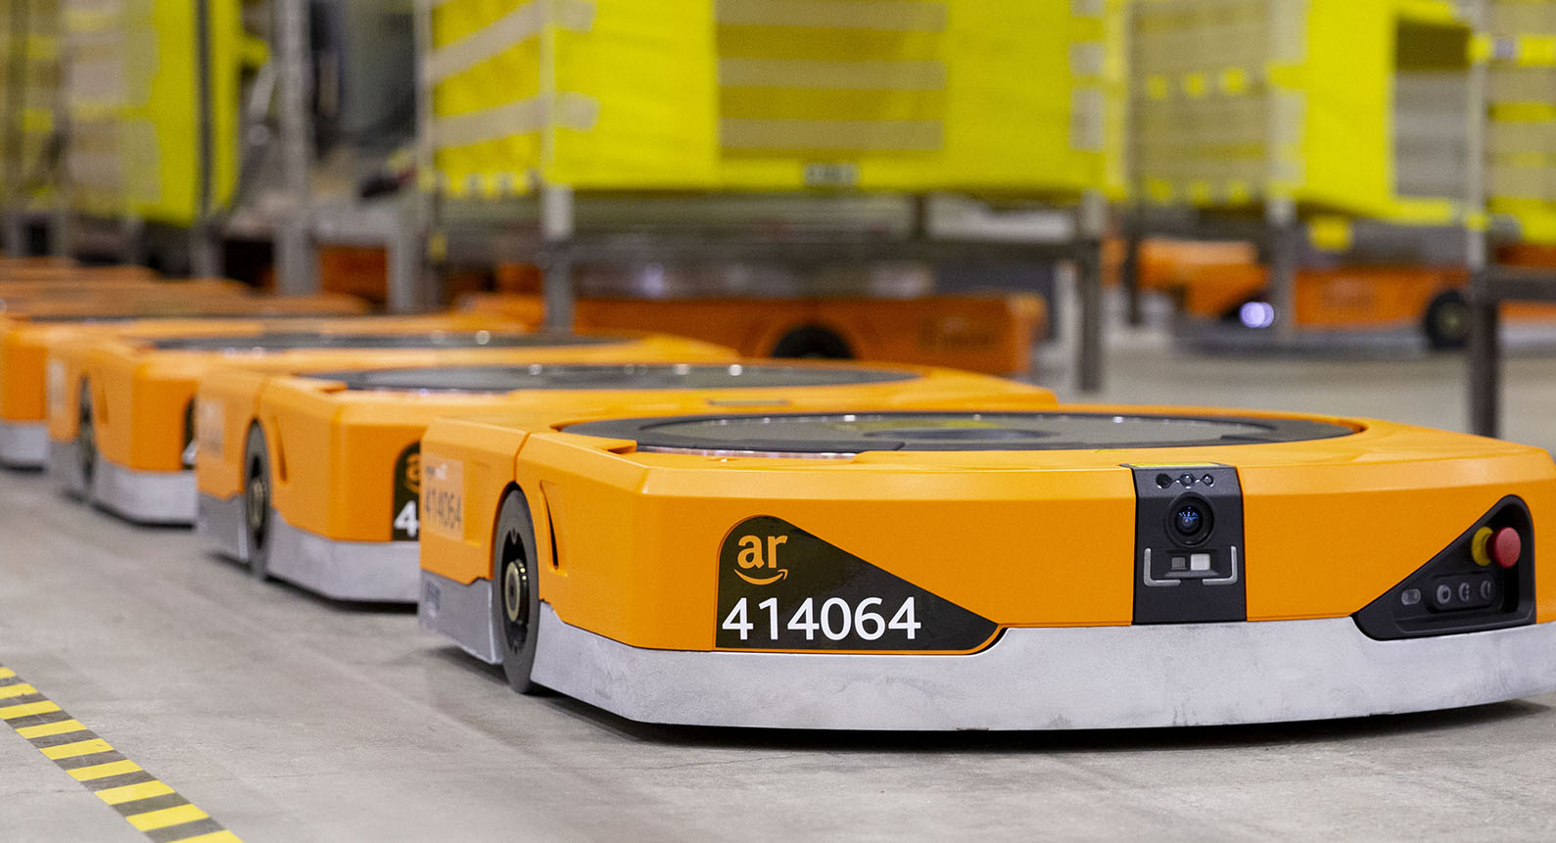
INTRODUCTION
Artificial Intelligence (AI) has been instrumental in almost every sector of human life.
Few AI driven and benefited fields are Agriculture, Transportation, Healthcare, Manufacturing, Military Guidance and Surveillance, and many more.
Search and rescue operation application, where path planning and obstacle avoidance is a major concern in domain.
Difficult during disaster for human to get into environment and get details of its root cause.
Making swarm of bots coordinate among themselves and making them take pictures of the scenario will ease the human work.

Slide 3
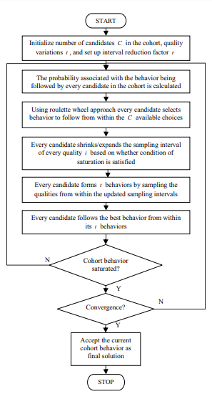
Introduction to Cohort Intelligence
Group of candidates interact and compete with one another to achieve some individual goal which is inherently common to all the candidates.
Candidate tries to improve its own behavior by observing every other candidate in that cohort (learn from one another).
The cohort behavior could be considered saturated, if for considerable number of learning attempts the individual behavior of all the candidates does not improve and becomes hard to distinguish.

Slide 4
FOLLOW ITSELF- Variation of CI
This rule suggests that every candidate c (c = 1,...,C) follows its own behavior.
Behavior of other candidates does not affect the path followed by a candidate at any stage.
This rule maintains the diversity in the search space and leads to the optimal solution in case of both uni-modal and multimodal functions.

Slide 5
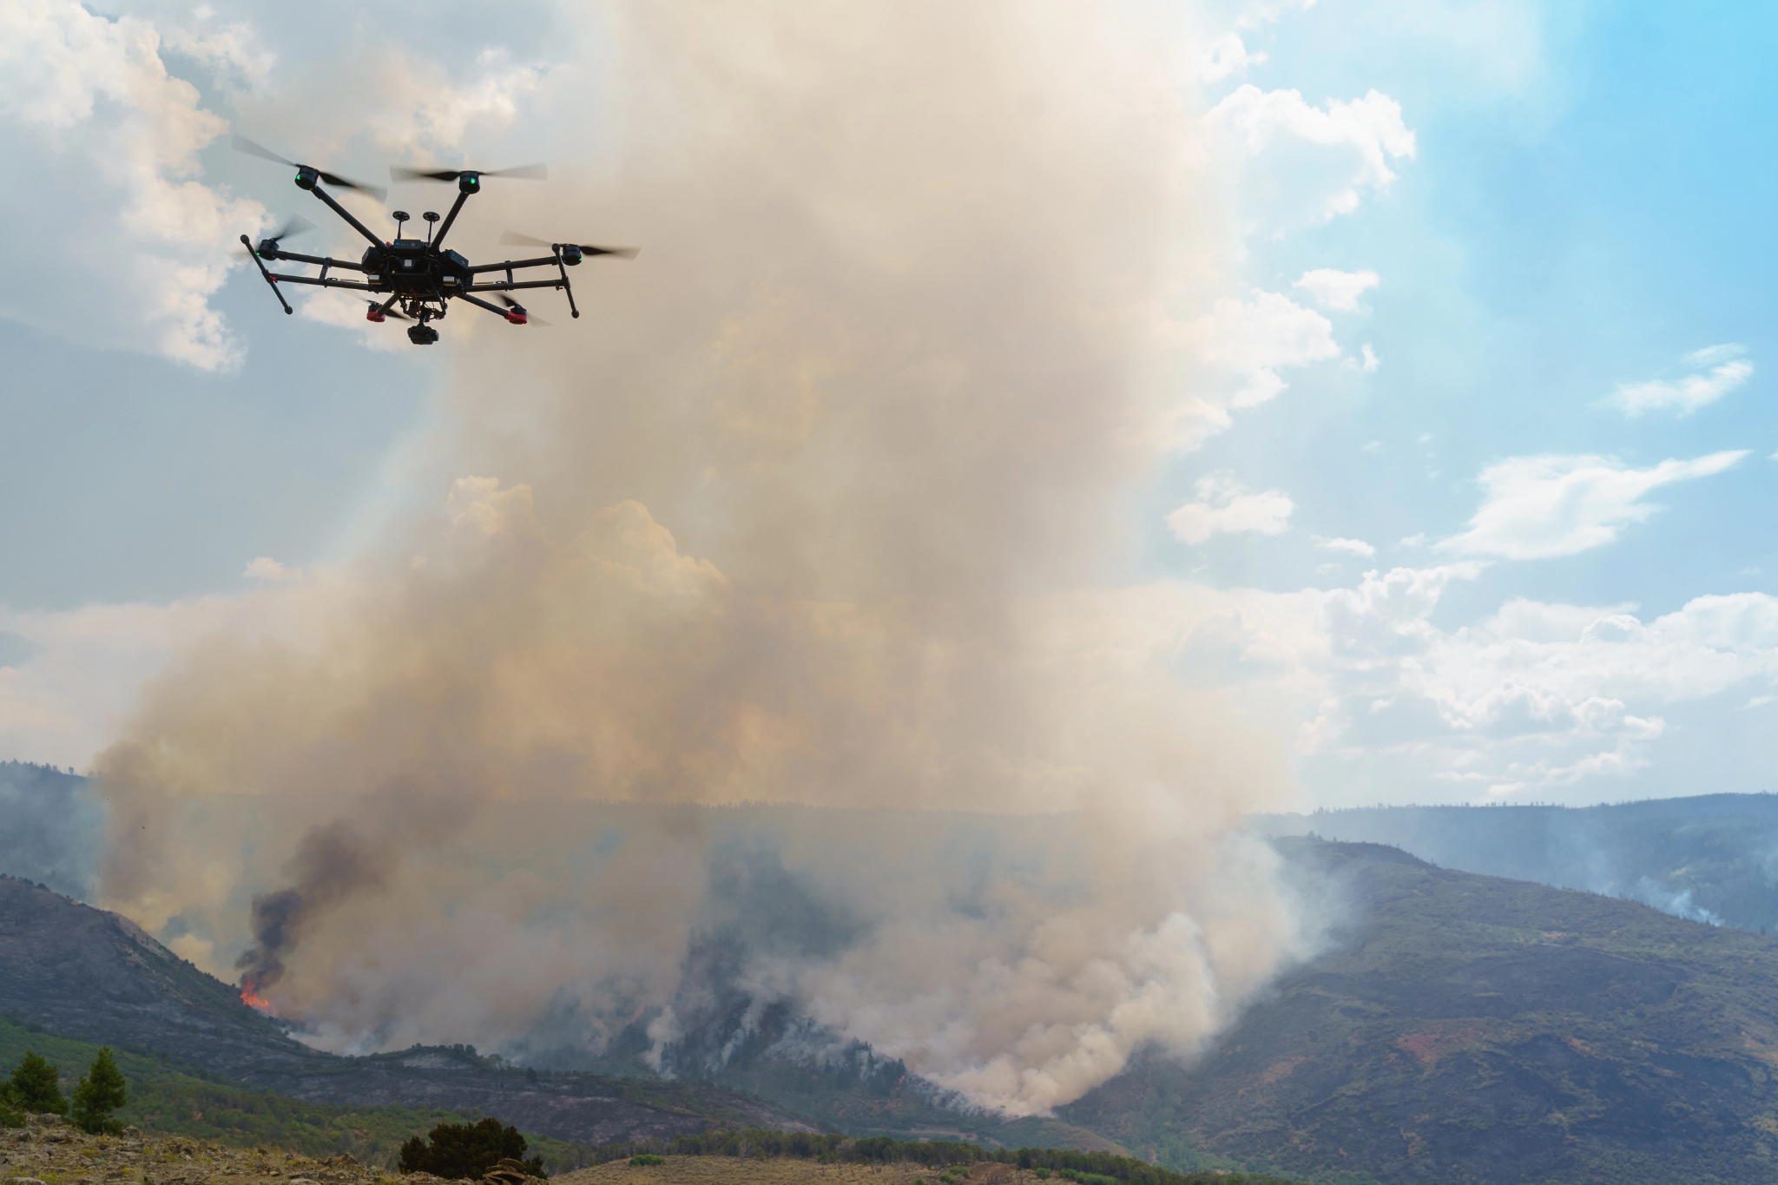
PROBLEM STATEMENT
Application of swarm robotics on 2d environment for disaster management using cohort intelligence

Slide 6
LITERATURE SURVEY
S. No | Title | Authors | Publisher | Methodology | Strong Points | Research Gap
1 | Cohort Intelligence: A Self Supervised Learning Behavior,2013 | Anand J. Kulkarni, Ishan P. Durugkar, Mrinal Kumar | IEEE International Conference on Systems, Man, and Cybernetics | Cohort Intelligence | Inspired from the candidates’ self supervised learning behavior in a cohort. Candidates interacting and competing with one another to achieve some individual goal which is inherently common to all the candidates. Approach is competitive, sufficiently robust with reasonable computational cost. | Sampling interval reduction factor r and needs to develop a self adaptive scheme for its fine tuning. The algorithm could be improved to make it solve constrained as well as combinatorial problems to make it further solve real world problems
2 | Variations of cohort intelligence,2021 | N. S. Patankar , Anand J. Kulkarni | Springer | Cohort Intelligence (CI) | The seven variations of CI are successfully proposed, validated and analyzed by solving seven multimodal and three uni-modal unconstrained test functions, and the numerical results are analyzed to decide which variation works best for particular type of problem . They follow median rule gives the best results for all the types of problems as it avoids getting stuck in the local minima and at the same time continues to improve the solution. | The proposed variations of CI may be used to solve other practically important problems such as traveling salesman, knapsack, multiple knapsack. Moreover, these variations of CI can be used to solve practically important fault tolerant systems in a distributed way

Slide 7
S. No. | Title | Authors | Publisher | Methodology | Strong Points | Research Gap
3 | Application of Swarm Robotic System in a Dynamic Environment using Cohort Intelligence, 2020 | Priya Bannur, Purvi Gujarathi, Karthik Jaina, Anand J Kulkarni | Elsevier | Cohort Intelligence | The obstacle avoidance and path planning of a swarm of robots is implemented while considering a dynamic environment. Calculation of performance of CI for 2 methods: Roulette wheel approach and Follow median approach for 6 test cases. The problem of robots getting stuck in the nonconvex obstacles has also been resolved using a perturbation technique. Mean of total traveled distance is significantly less in the follow median approach than in the roulette wheel approach. | Different planes for obstacles and robots have not been considered here. Making use of multiple proximity sensors on the robots or by making use of computer vision technology.
4 | Multi-robot exploration using Dynamic Fuzzy Cognitive Maps and Ant Colony Optimization, 2020 | Márcio Mendonça, Rodrigo H. C. Palácios, Elpiniki I. Papageorgiou, Lucas Botoni de Souza | IEEE | Fuzzy Logic Controller , a dynamic fuzzy cognitive map, DFCM inspired by the ant colony optimization | Three approaches: FLC, DFCM, DFCM-ACO used to rescue victims in unknown environments.. MRS have three tasks: 1) to detect and avoid static and dynamic (other robots) obstacles; 2) locate and rescue all the victims, and 3) map the environments. DFCM-based MRS approaches are able to complete the tasks consuming less processing time, with robots travelling shorter distances to explore a similar environment to the FLC approach and with the DFCM-ACO presenting balanced results between the other techniques. | The number of robots were very limited. No validation is done through experiments with prototype. The robots don’t have a collaborative behavior or a leader concept for the group.

Slide 8
S. No. | Title | Authors | Publisher | Methodology | Strong Points | Research Gap
5 | SWARM-BOT: an experiment in swarm robotics,2019 | M. Dorigo | IEEE | Swarm Bot Using ANN(Artificial Neural Network) | The self-assembling ability of the s-bots enables a group of them to execute tasks that are beyond the capabilities of the single s-bot. S-bots equipped with the evolved controllers successfully displayed individual and collective obstacle avoidance, individual and collective photo-taxis, aggregation and self-assembling. | In this work, swarm bots are made to work in coordinated motion on rough terrain, hole and obstacle avoidance, self-assembling, cooperative transport and environment exploration and path formation.the problems faced by them are how to efficiently allocate tasks to different s-bots and how to appropriately trigger the s-bots' self-assembling behavior
6 | An Algorithm for Swarm Robot to Avoid Multiple Dynamic Obstacles and to Catch the Moving Target, 2019 | Quoc Bao Diep, Ivan Zelinka, Romaan Senkerik | Springer International Publishing | Self-organizing Migrating Algorithm(SOMA) | SOMA emerges as a fast, powerful and efficient algorithm. Starting point - mountain top, target - lowest lying land, obstacles - small hills, robots - water. SOMA will create a next point that robot must pass through Ways leaving the robot moving away from the trapped area when the robot be held by the surrounding obstacles. | Method is for single robot, no discussion on how swarm of robots will coordinate with each other and distribute work.

Slide 9
About The Project
In a 2D environment, there are bots(candidates) with certain vision, obstacles and interest points.
Objective-1 is to maximize the area covered by the candidates and to detect these interest points along with it using a variation of cohort intelligence.
Objective-2 is to use a variation of cohort intelligence to direct the candidates to exit the environment.
Two cases:
No Obstacle Case
Static Obstacle Case

Slide 10
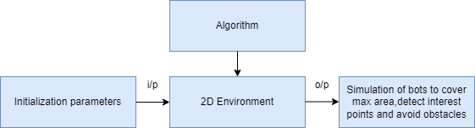
HIGH LEVEL DESIGN

Slide 11
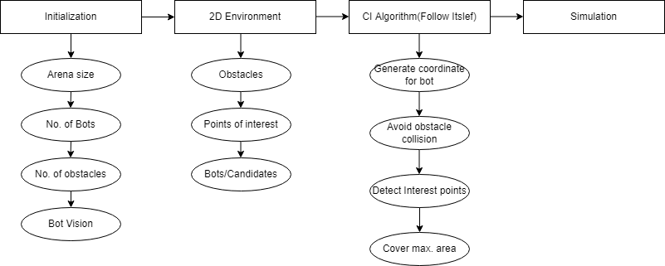
LOW LEVEL DESIGN

Slide 12
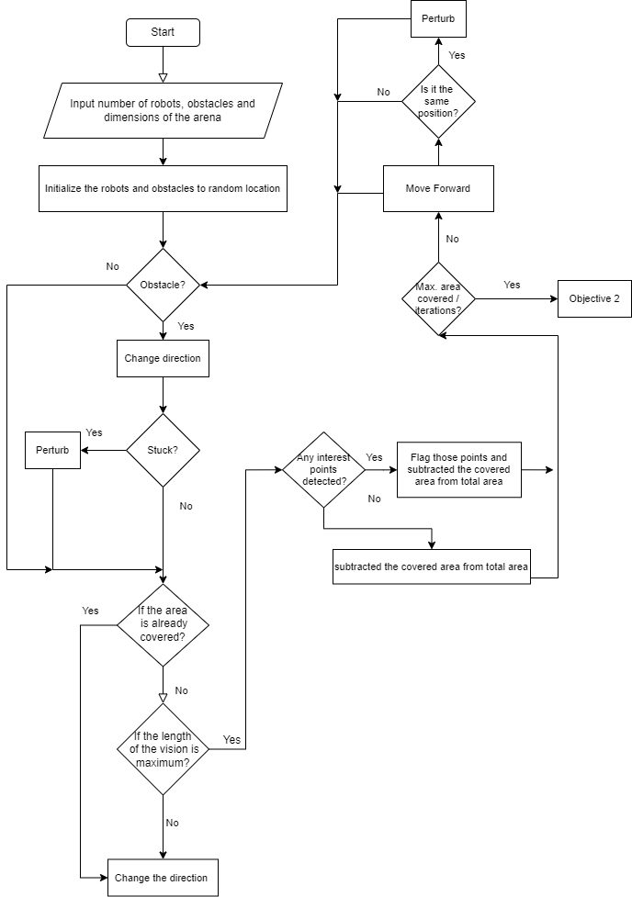
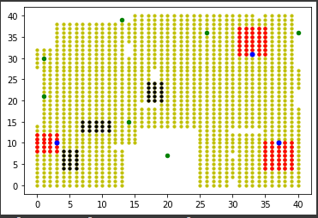
METHODOLOGY
Objective 1: Candidate movement to cover maximum area and detect interest points

Slide 13
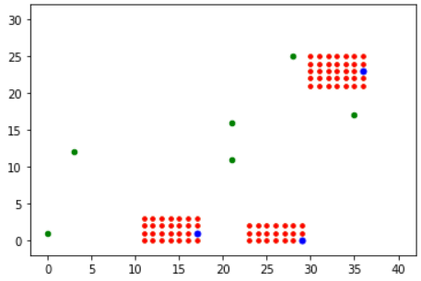
RESULT FOR OBJECTIVE 1- No Obstacle Case
Blue: Candidate
Red: Vision
Green: Interest Points
Number of Candidates:3
Length of Arena:40
Breadth of Arena:30
Number of interest points:6
For iteration=1

Slide 14
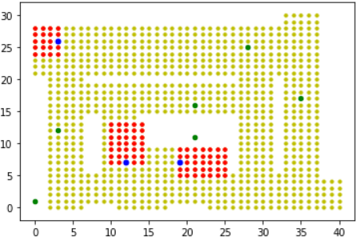
RESULT FOR OBJECTIVE 1- No Obstacle Case
Blue: Candidate
Red: Vision
Green: Interest Points
Yellow: Area Covered
Number of Candidates:3
Length of Arena:40
Breadth of Arena:30
Number of interest points:6
For iteration=50

Slide 15
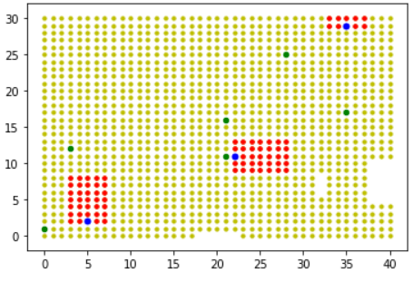
RESULT FOR OBJECTIVE 1- No Obstacle Case
Blue: Candidate
Red: Vision
Green: Interest Points
Yellow: Area Covered
Number of Candidates:3
Length of Arena:40
Breadth of Arena:30
Number of interest points:6
For iteration=final

Slide 16
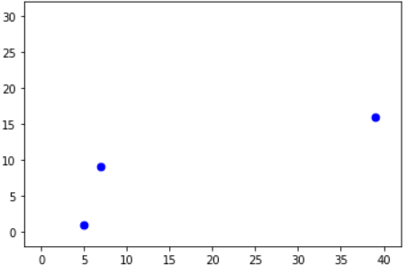
RESULT FOR OBJECTIVE 2- No Obstacle Case
Blue: Candidate
Number of Candidates:3
Length of Arena:40
Breadth of Arena:30
Number of interest points:6
For iteration=0

Slide 17
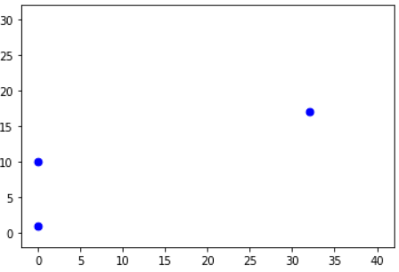
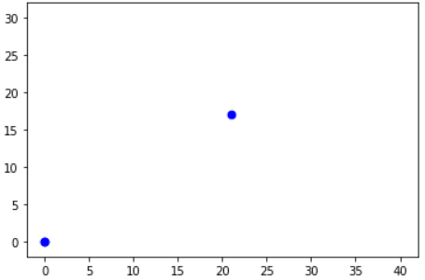

RESULT FOR OBJECTIVE 2- No Obstacle Case
Candidate 1 reached the exit
Candidate 2 reached the exit
Candidate 0 reached the exit

Slide 18
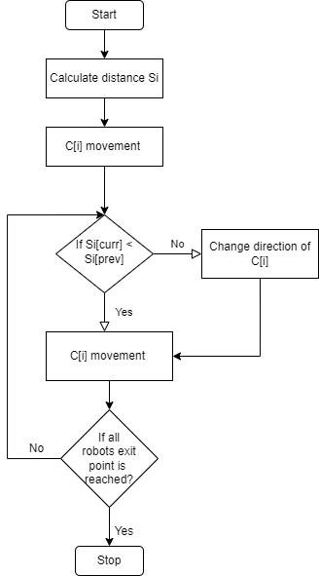
Objective 2 : Getting the candidate out of the environment

Slide 19
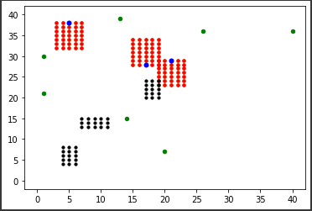
RESULT FOR OBJECTIVE 1- Static Obstacle Case
Blue: Candidate
Red: Vision
Green: Interest Points
Number of Candidates:3
Length of Arena:40
Breadth of Arena:30
Number of interest points:6
For iteration=1

Slide 20
RESULT FOR OBJECTIVE 1- Static Obstacle Case
Blue: Candidate
Red: Vision
Green: Interest Points
Number of Candidates:3
Length of Arena:40
Breadth of Arena:30
Number of interest points:6
For iteration=100

Slide 21
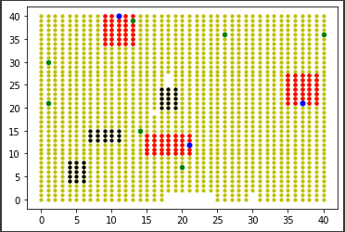
RESULT FOR OBJECTIVE 1- Static Obstacle Case
Blue: Candidate
Red: Vision
Green: Interest Points
Number of Candidates:3
Length of Arena:40
Breadth of Arena:30
Number of interest points:6
For iteration=final

Slide 22
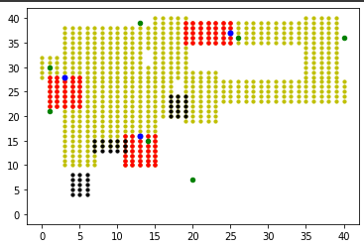
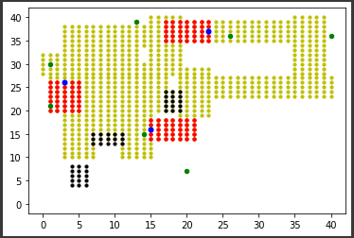
RESULT FOR OBJECTIVE 1- Static Obstacle Case
Before Obstacle Avoidance
After Obstacle Avoidance

Slide 23
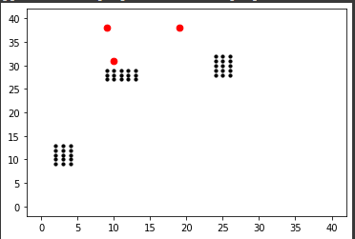
RESULT FOR OBJECTIVE 2- Static Obstacle Case
Blue: Candidate
Number of Candidates:3
Length of Arena:40
Breadth of Arena:30
Number of interest points:6
For iteration=0

Slide 24
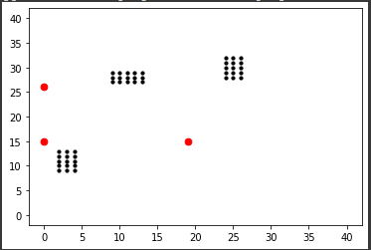
RESULT FOR OBJECTIVE 2- Static Obstacle Case
Blue: Candidate
Number of Candidates:3
Length of Arena:40
Breadth of Arena:30
Number of interest points:6
For iteration=100

Slide 25
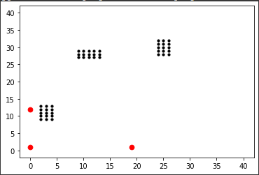
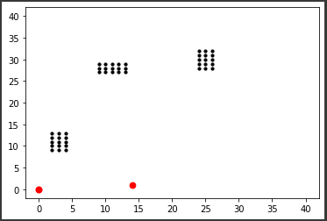
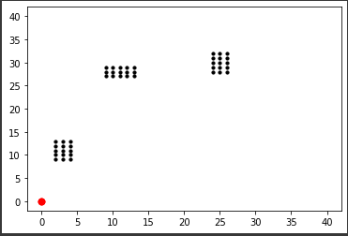
RESULT FOR OBJECTIVE 2- Static Obstacle Case
Candidate 0 reached the exit
Candidate 1 reached the exit
Candidate 2 reached the exit

Slide 26
TEST CASES
The length and breadth of the arena should be greater than or equal to 10 times the number of candidates.
The candidate will try to maximise the vision.
The vision of the candidate should not exceed the arena length.
If the candidate is stuck i.e it does not find any new points around it for a certain iteration, perturb the candidate by a certain angle.

Slide 27
CONCLUSION
The application of Swarm robotics in Search and Rescue operation was implemented using CI methodology with a follow-itself approach. To make this closer to real-life scenario, the entire system is to be considered dynamic in nature. This implementation was successfully validated for following independent static test cases: No obstacle and with obstacle cases. The tests were conducted by arbitrarily positioning the robots and obstacles in the arena.

Slide 28
FUTURE SCOPE
This project shows the implementation of an application considering a single plane while more complex real-life problems can also be solved using this methodology considering the robots and obstacles in different planes. This work can have strong potential when implemented in a 3D environment for applications like assistive swarm-robotics in rescue operations, disaster management, aerial swarm robotics and aquatic swarm-robotics.

Slide 29


Slide 30
REFERENCES
Bannur, Priya; Gujarathi, Purvi; Jain, Karthik; Kulkarni, Anand J (2020). Application of Swarm Robotic System in a Dynamic Environment using Cohort Intelligence. Soft Computing Letters, 2(), 100006–. doi:10.1016/j.socl.2020.100006
Kulkarni, Anand J.; Durugkar, Ishan P.; Kumar, Mrinal (2013). [IEEE 2013 IEEE International Conference on Systems, Man and Cybernetics (SMC 2013) - Manchester (2013.10.13-2013.10.16)] 2013 IEEE International Conference on Systems, Man, and Cybernetics - Cohort Intelligence: A Self Supervised Learning Behavior. , (), 1396–1400. doi:10.1109/smc.2013.241
Patankar, Neha & Kulkarni, Anand. (2018). Variations of cohort intelligence. Soft Computing. 22. 1-17. 10.1007/s00500-017-2647-y.
Mendonca, Marcio; Palacios, Rodrigo H. C.; Papageorgiou, Elpiniki I.; de Souza, Lucas Botoni (2020). [IEEE 2020 IEEE International Conference on Fuzzy Systems (FUZZ-IEEE) - Glasgow, United Kingdom (2020.7.19-2020.7.24)] 2020 IEEE International Conference on Fuzzy Systems (FUZZ-IEEE) - Multi-robot exploration using Dynamic Fuzzy Cognitive Maps and Ant Colony Optimization. , (), 1–8. doi:10.1109/FUZZ48607.2020.9177814
Dorigo, Marco. (2005). SWARM-BOT: an experiment in swarm robotics. 2005. 192 - 200. 10.1109/SIS.2005.1501622.
Diep, Quoc Bao & Zelinka, Ivan & Senkerik, Roman. (2019). An Algorithm for Swarm Robot to Avoid Multiple Dynamic Obstacles and to Catch the Moving Target. 10.1007/978-3-030-20915-5_59.

Slide 31
THANK YOU

